Slide 1
Q4:Correlation between age and whether the purchase was made online or in store; other predictors of how the purchase was made
The analysis of our data set showed that there was a definite correlation between the age of the person and whether the purchase was made in-store or online. We were able to determine this using machine learning to build predictive models.

Slide 2
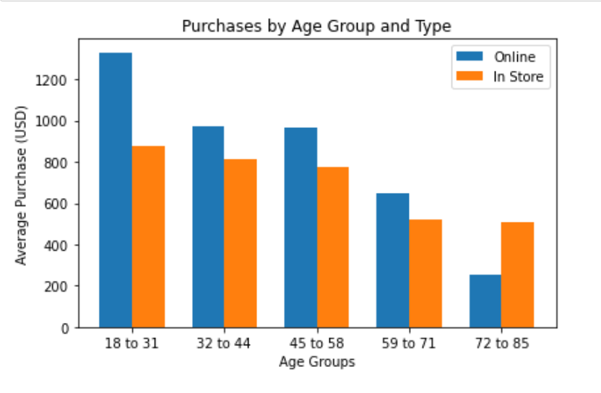
[Q4]
This graph shows that age was predictive of if the purchase was made in-store or online. The younger the person is the more likely it is for them to make the purchase online.

Slide 3
[Q4]
Age was a strong enough predictor that when combined with other demographic and purchase data we were able to build a model that was close to 90% accuracy(GBC:0.887). However, Age was not the only variable that was a strong predictor of on-line vs in-store. Region was also a strong indicator for how the purchase was made. In fact, using only Age and Region we were able to produce a model that was almost 80% accurate (DCT, GBC, RFC: 0.7930)

